Slide 1



FinalProject_SriSangeetha
View in Power BI
Last data refresh:
26/03/2023 11:40:52 UTC
Downloaded at:
26/03/2023 13:32:46 UTC

Slide 2
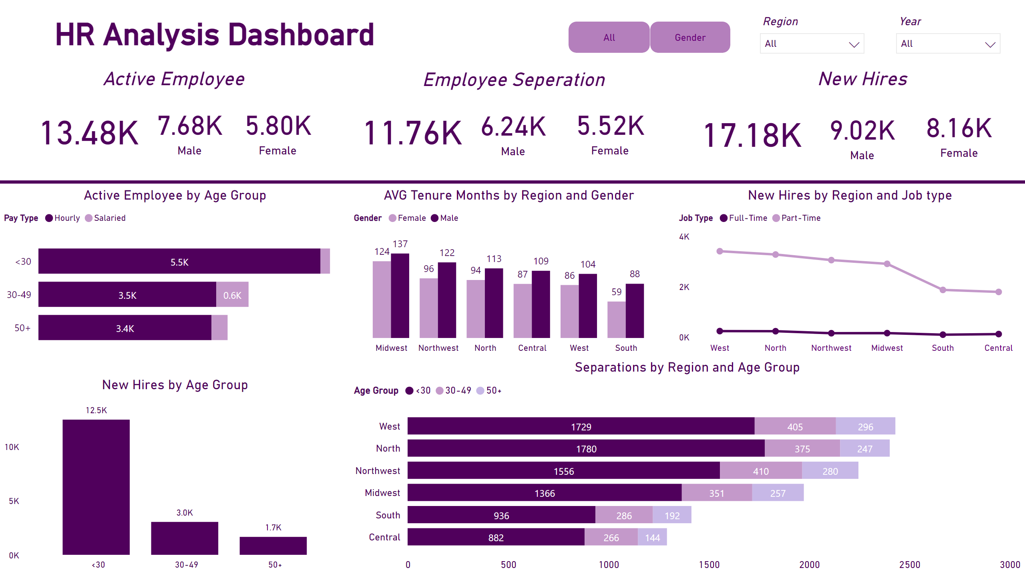
Summary
Notes:
shape
No alt text provided
textbox
No alt text provided
textbox
No alt text provided
card
No alt text provided
card
No alt text provided
card
No alt text provided
textbox
No alt text provided
textbox
No alt text provided
card
No alt text provided
card
No alt text provided
card
No alt text provided
card
No alt text provided
card
No alt text provided
card
No alt text provided
slicer
No alt text provided
Active Employee by Age Group
No alt text provided
clusteredColumnChart
No alt text provided
lineChart
No alt text provided
New Hires by Age Group
No alt text provided
Separations by Region and Age Group
No alt text provided
slicer
No alt text provided
shape
No alt text provided
barChart
No alt text provided
pivotTable
No alt text provided
shape
No alt text provided

Slide 3
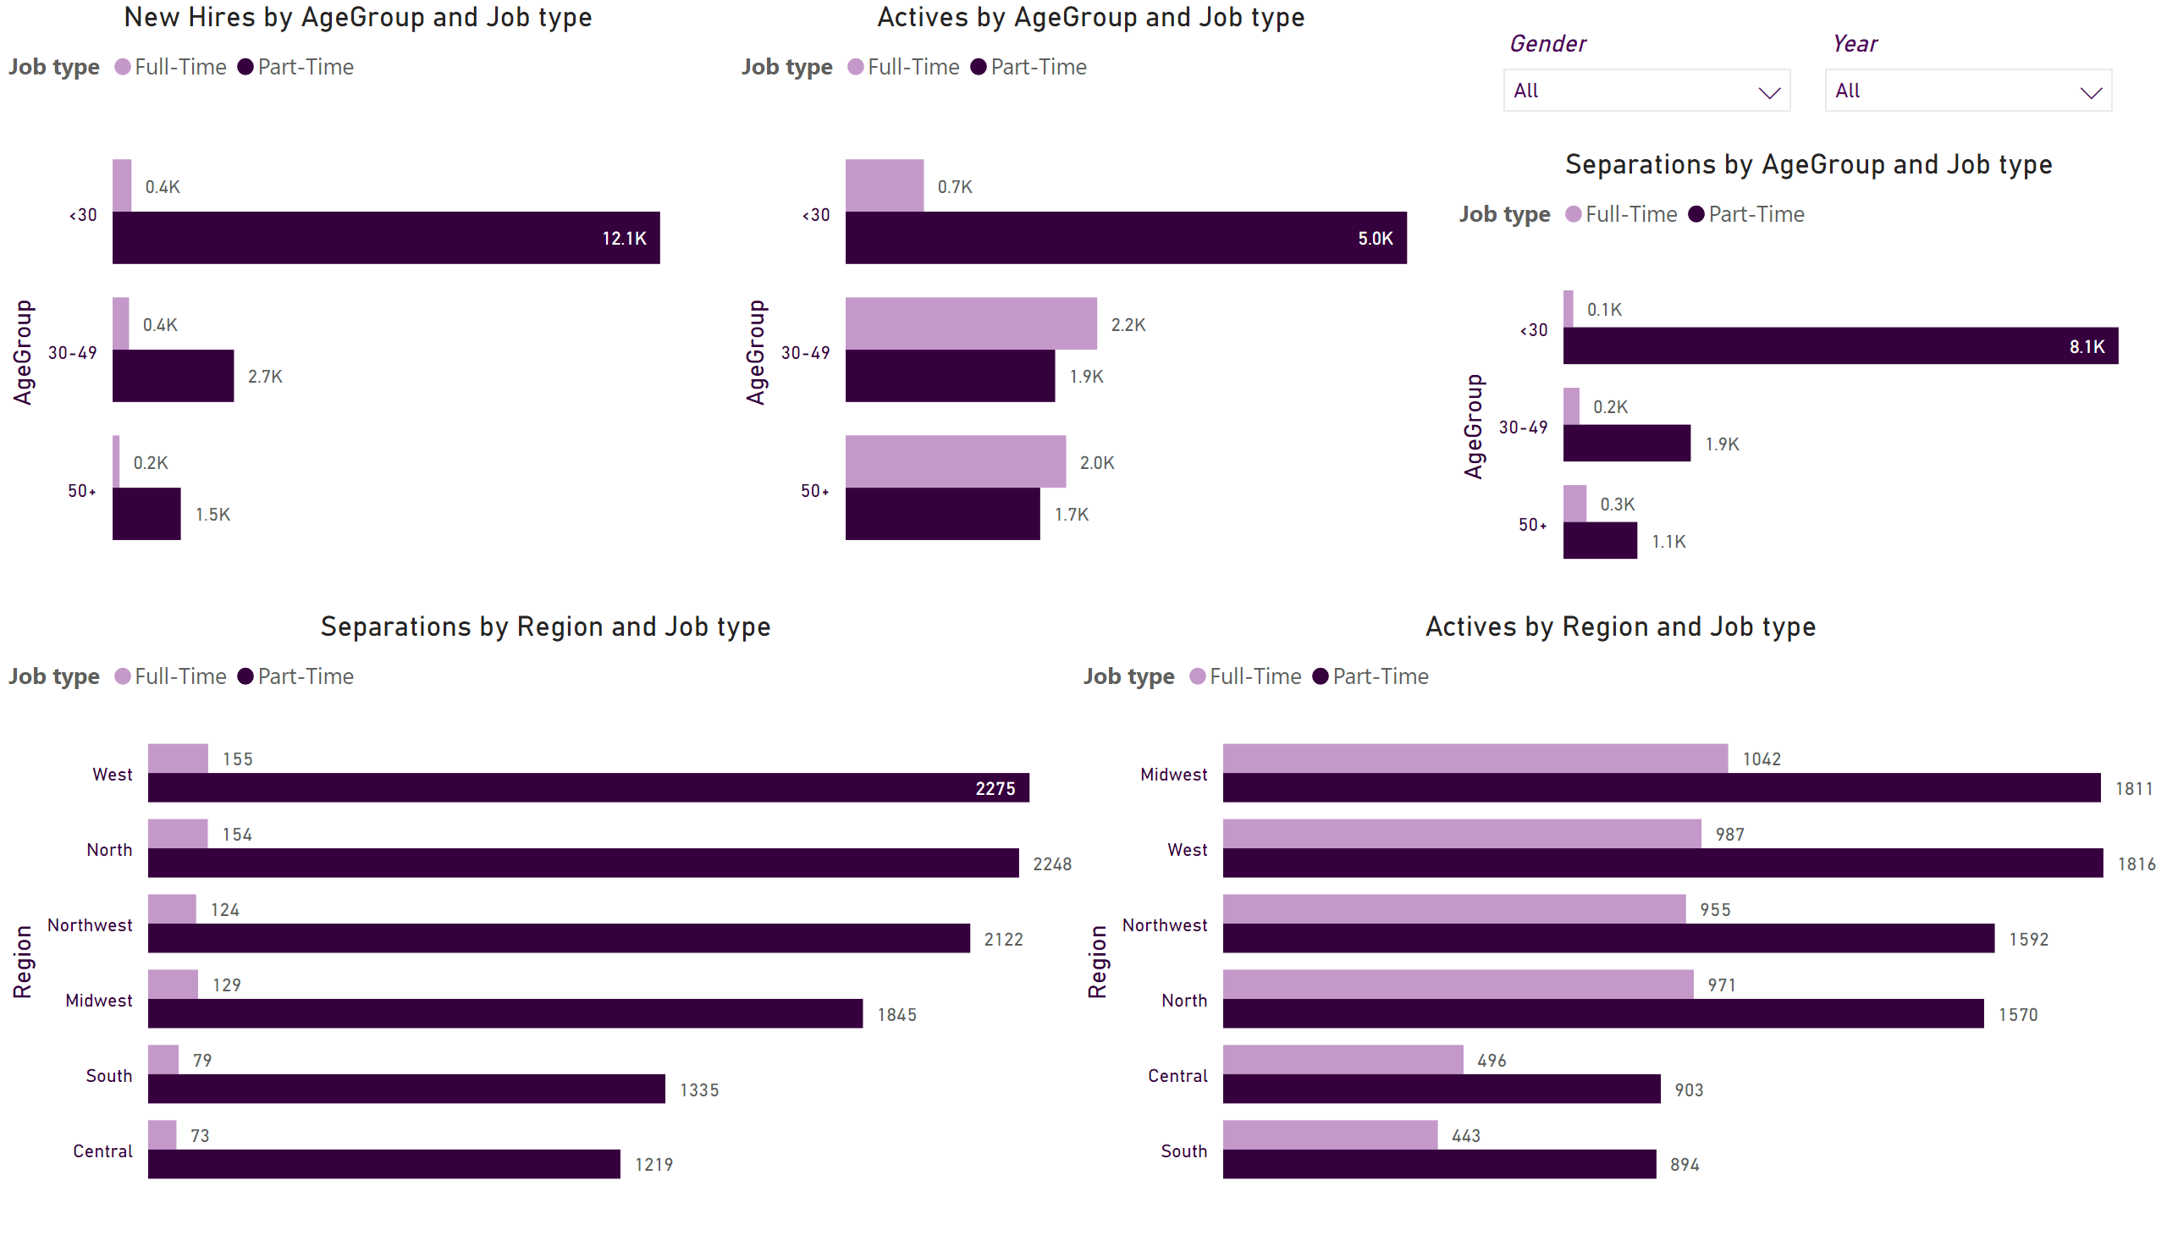
Job Type/Region
Notes:
clusteredBarChart
No alt text provided
clusteredBarChart
No alt text provided
clusteredBarChart
No alt text provided
clusteredBarChart
No alt text provided
clusteredBarChart
No alt text provided
slicer
No alt text provided
slicer
No alt text provided

Slide 4
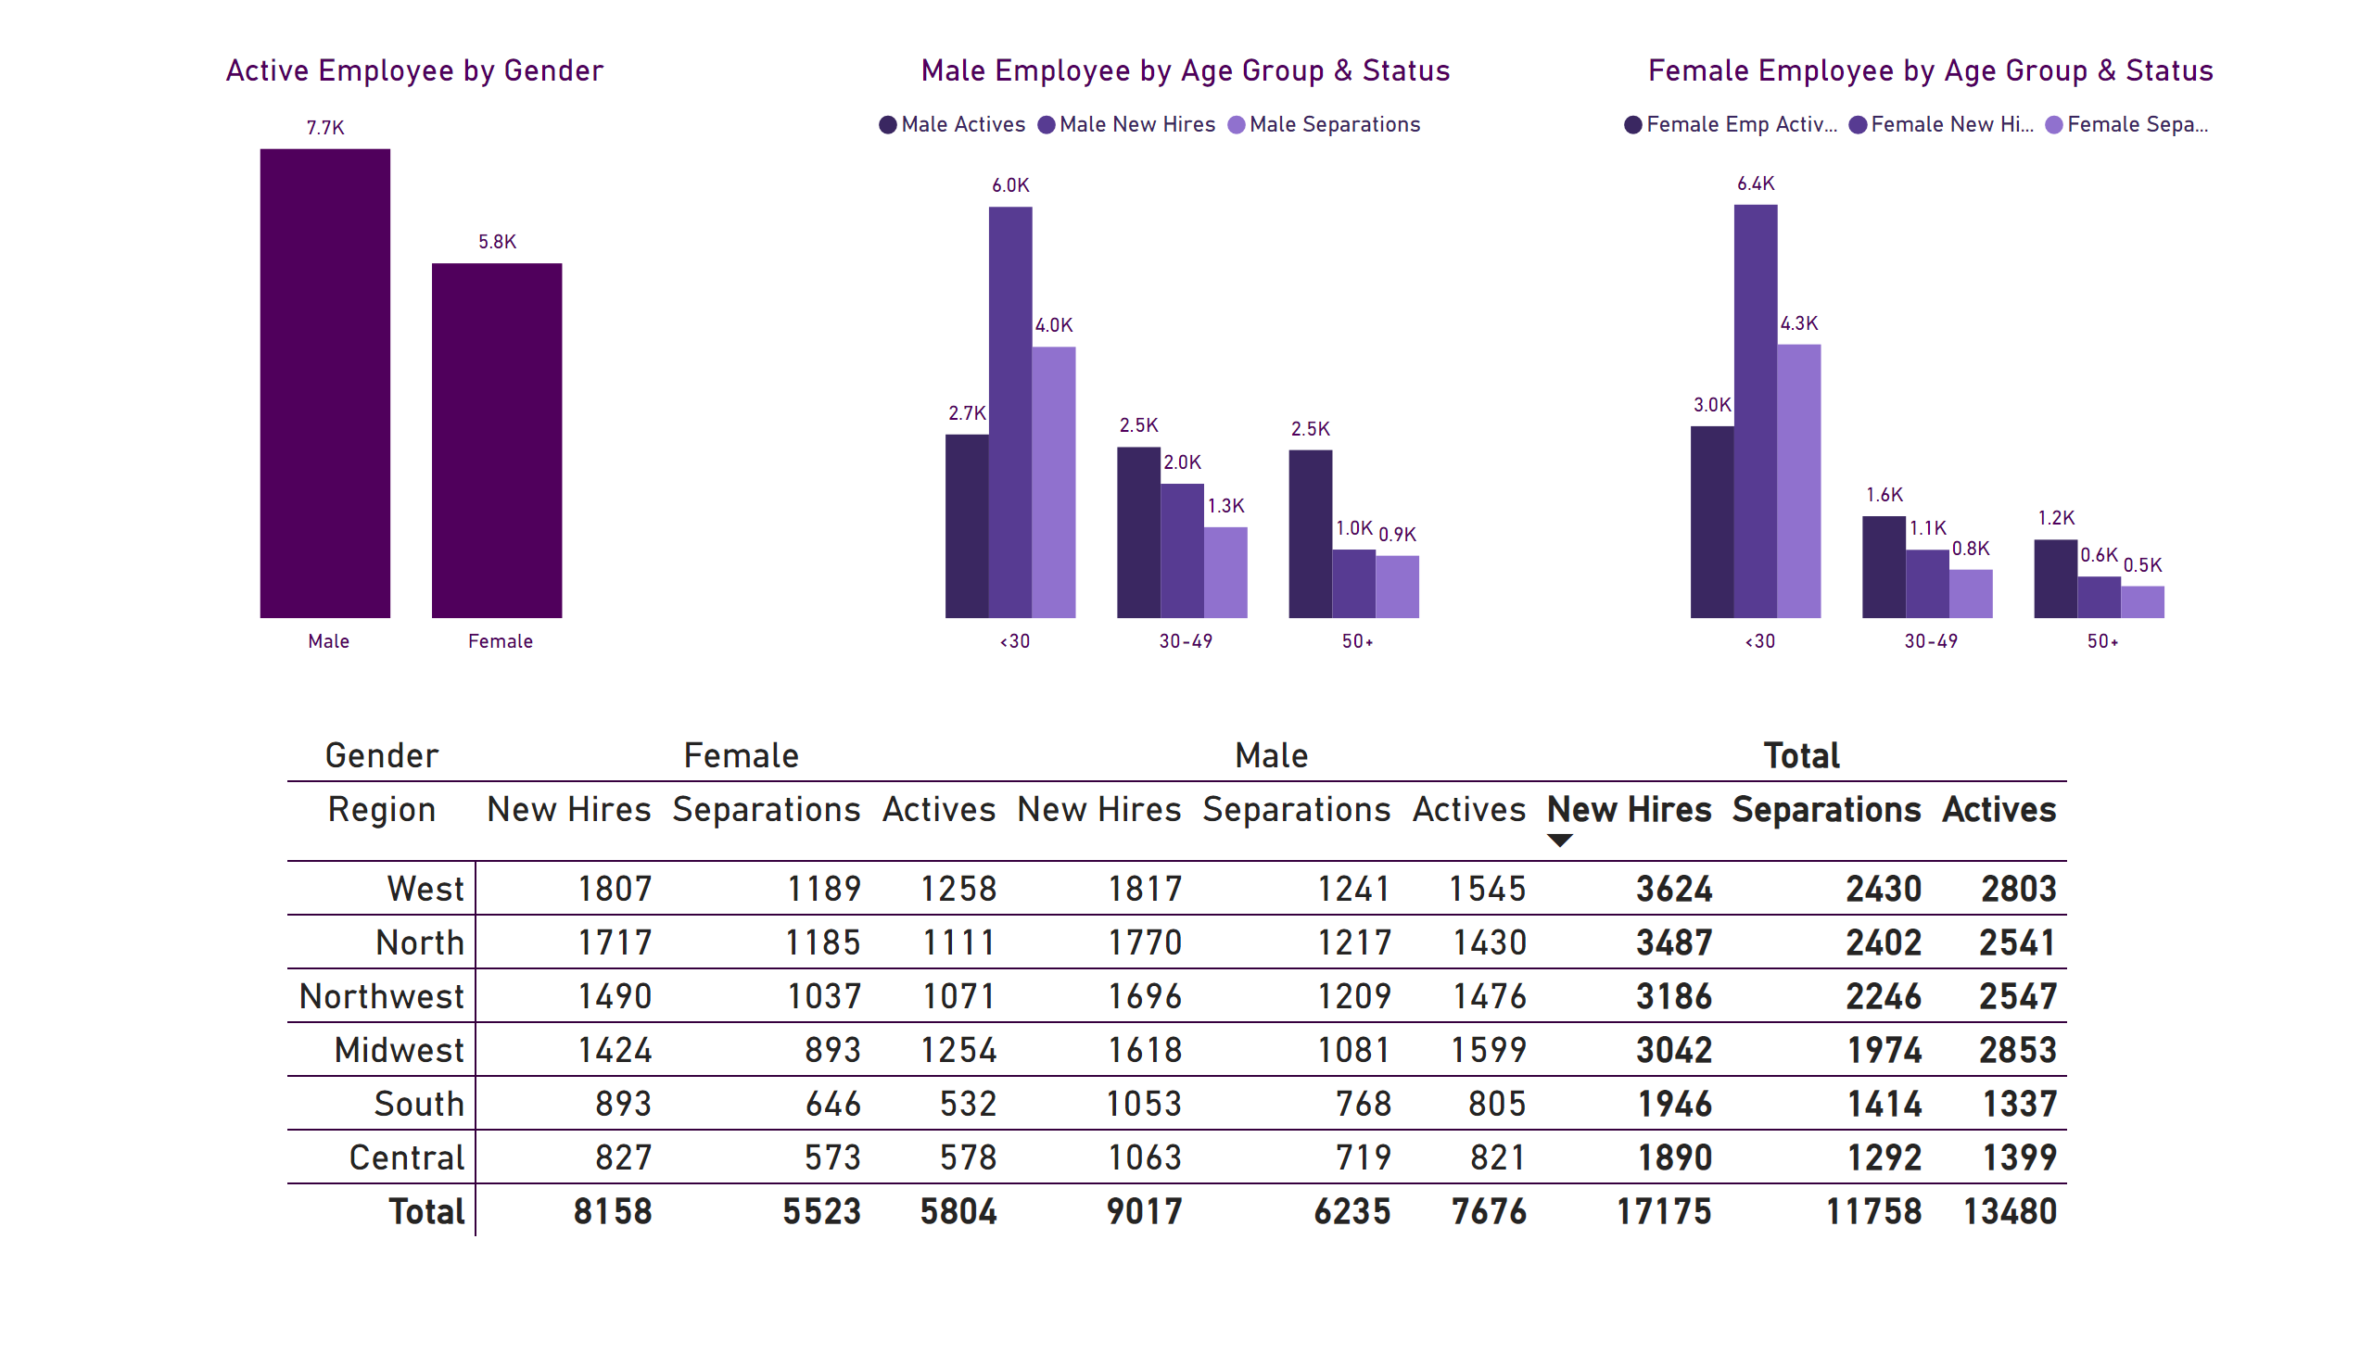
Gender
Notes:
Active Employee by Gender
No alt text provided
Male Employee by Age Group & Status
No alt text provided
Female Employee by Age Group & Status
No alt text provided
pivotTable
No alt text provided

Slide 5
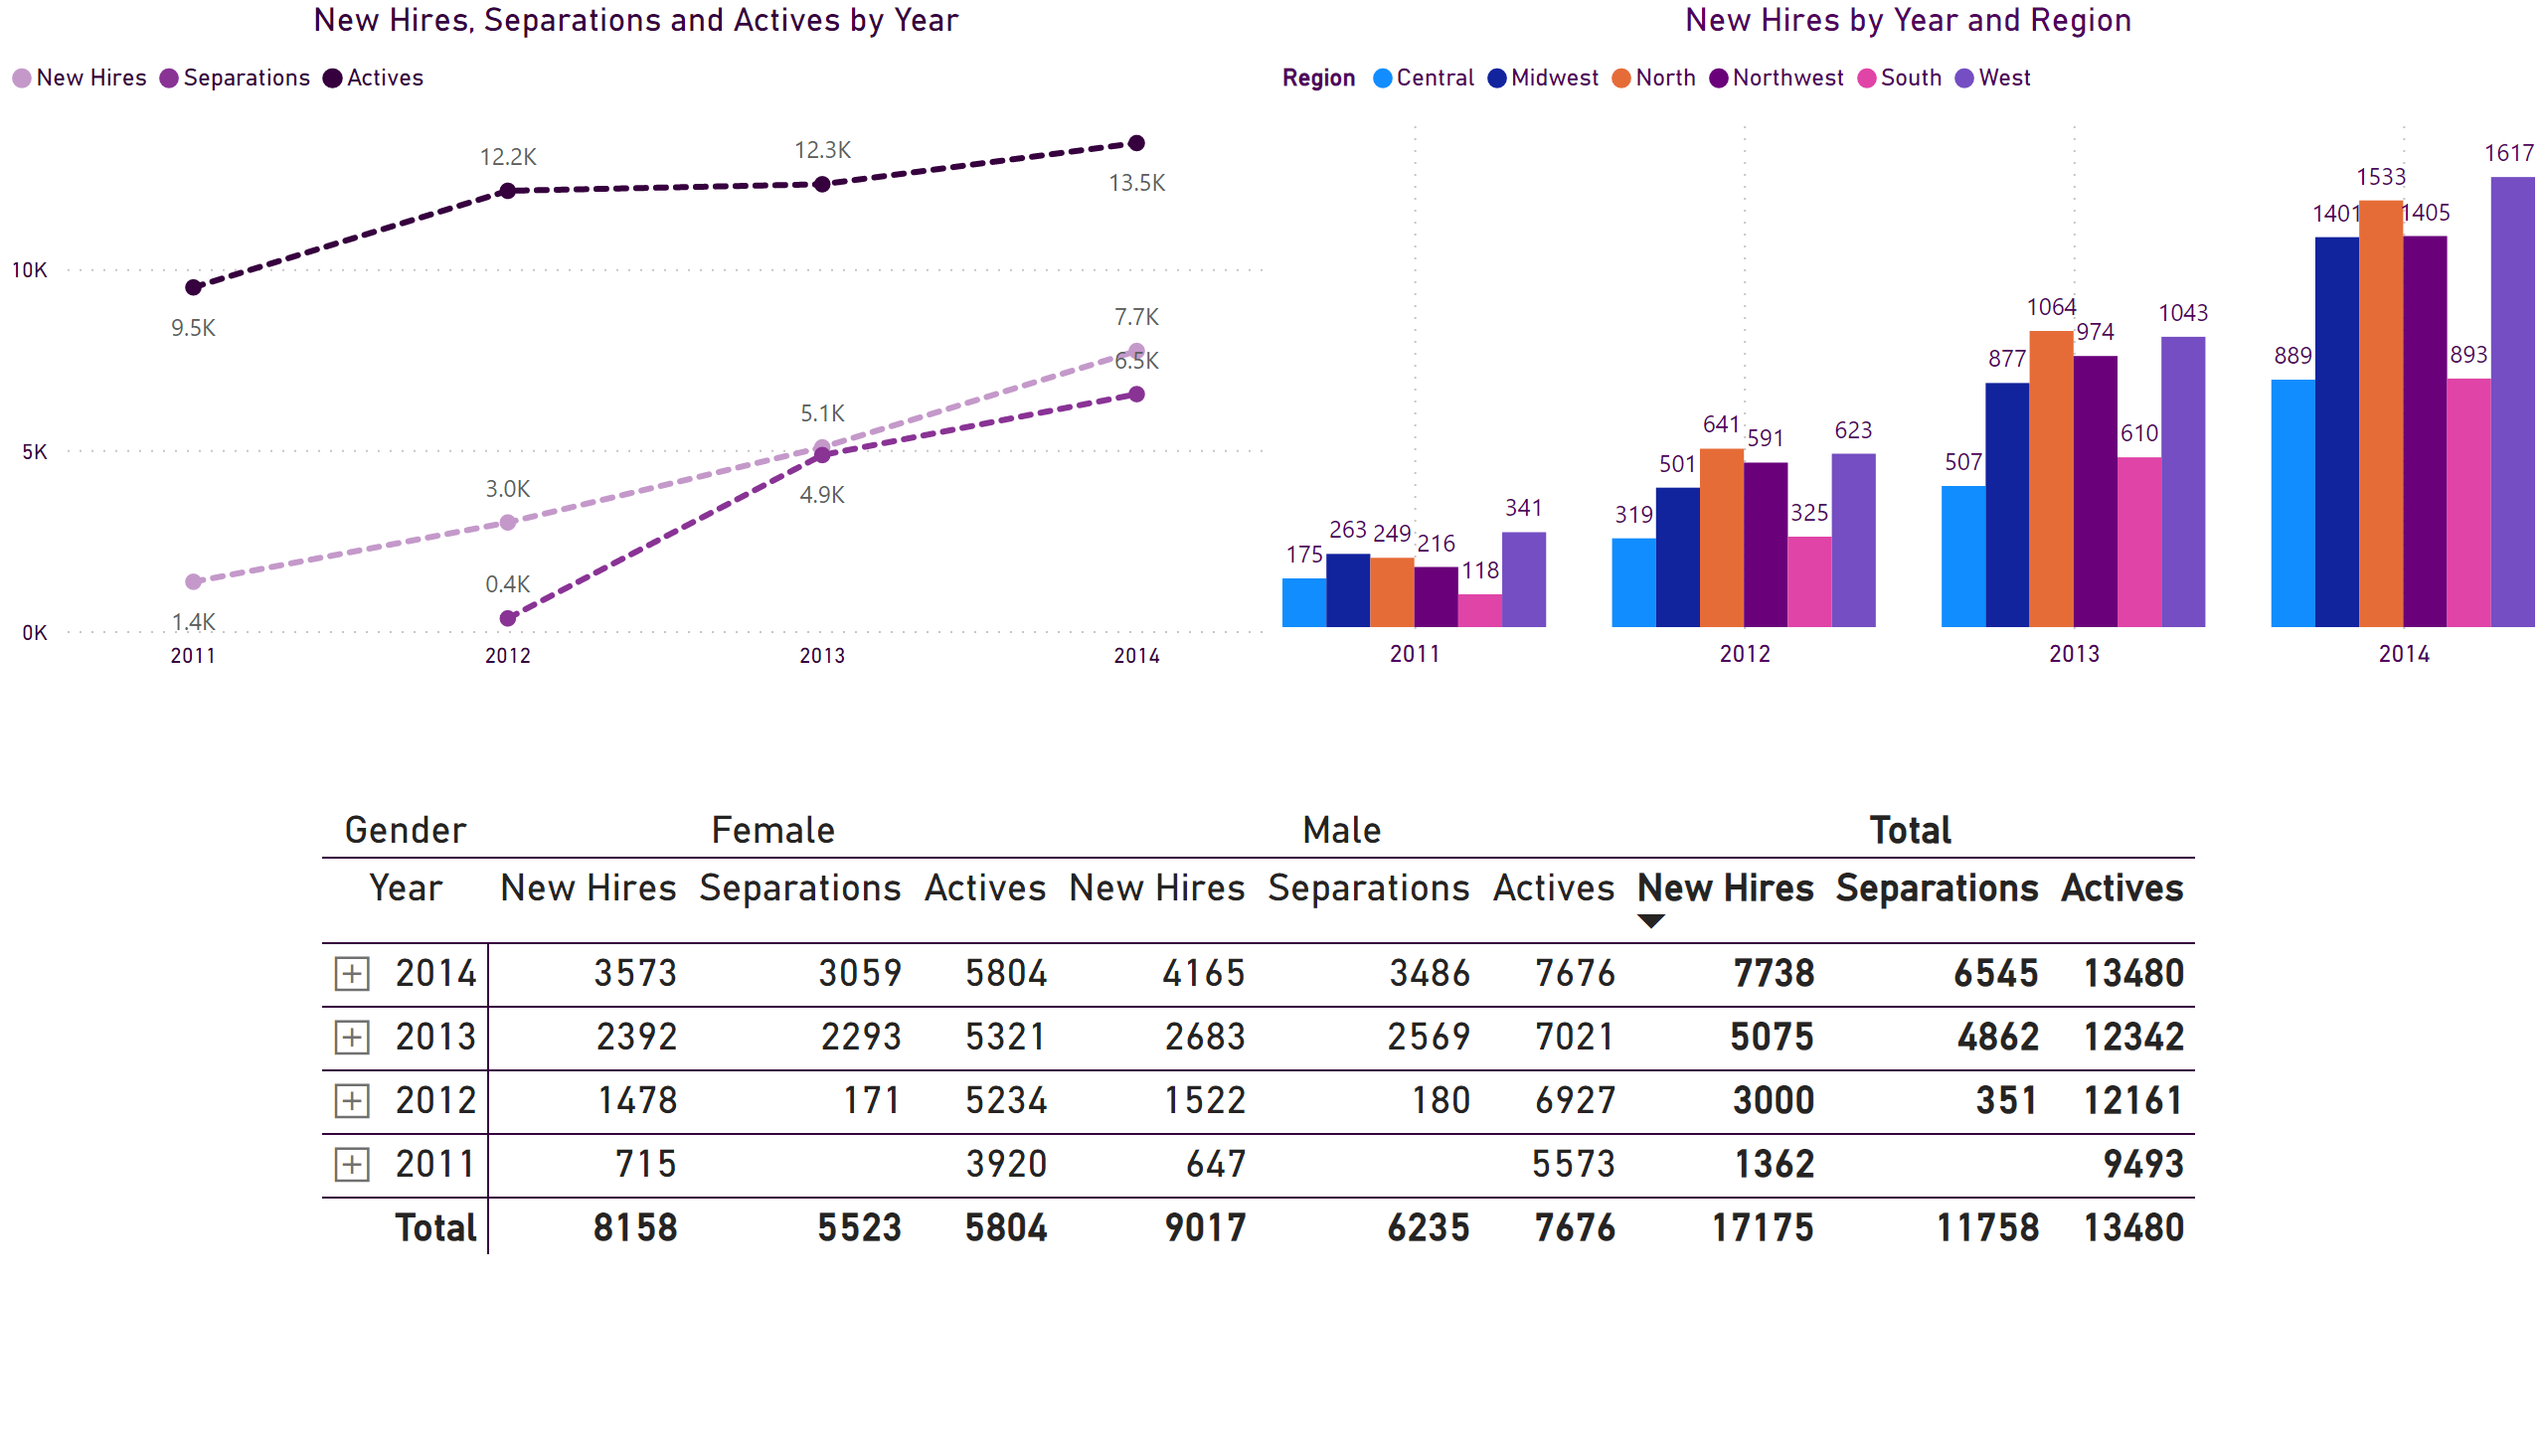
Date
Notes:
lineChart
No alt text provided
pivotTable
No alt text provided
clusteredColumnChart
No alt text provided

